Slide 1
Basic Router Config
202130071251 沈文轩
202130430287 姚炯森
202130430294 叶晓明
202130430270 杨 圣
202130430263 杨 峻
202130430157 刘彦廷

Slide 2
行业PPT模板http://www.1ppt.com/hangye/
目录
01
Introduction to Routers
CONTENTS
02
Remote Access
03
Five Working Modes
04
Commands
05
Manual Configuration
06
Experiment on Cisco Packet Tracer

Slide 3
PART 01
Introduction to Routers
Introduction to Routers
Remote Access
Five Working Modes
Commands
Manual Configuration
Experiment

Slide 4
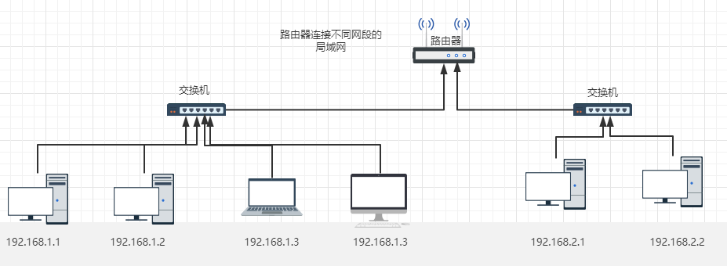
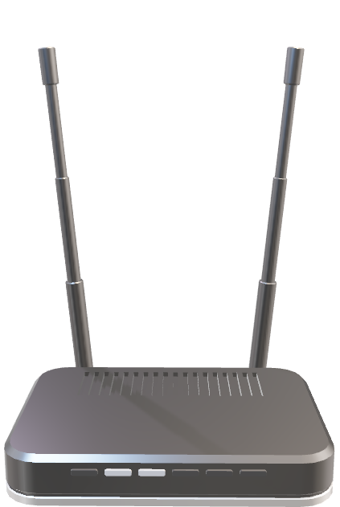
Router and Switch
Router: addressing, forwarding (depending on IP address)
Switch: filtering, forwarding (depending on MAC address)
The switch is used to connect the LAN, and the data packet is forwarded in the LAN
The router is used to connect the LAN and the external network, and the data packet can be forwarded in different Lans.
Introduction to Routers
Remote Access
Five Working Modes
Commands
Manual Configuration
Experiment

Slide 5
Function
Routing
Forwarding
NAT (Network Address Translation)
Packet Filtering
Broadcast Management
Interconnectivity
Introduction to Routers
Remote Access
Working Modes
Commands
Manual Configuration
Experiment

Slide 6


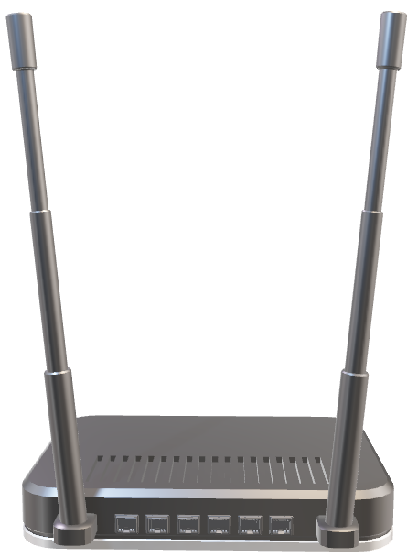
Structure
Internet
modem
Computer connect arbitrary LAN interface
WAN
LAN
Introduction to Routers
Remote Access
Working Modes
Commands
Manual Configuration
Experiment

Slide 7
Structure
Routing processor
Routing selection part
Routing protocol
routing table
Input port
output port
physical
link
network
packet processing
network
link
physical
Forward
part
…
…
forwarding table
Input port
output port
physical
link
network
switch fabric
network
link
physical
Introduction to Routers
Remote Access
Working Modes
Commands
Manual Configuration
Experiment

Slide 8
PART 02
Remote access
Introduction to Routers
Remote Access
Working Modes
Commands
Manual Configuration
Experiment

Slide 9
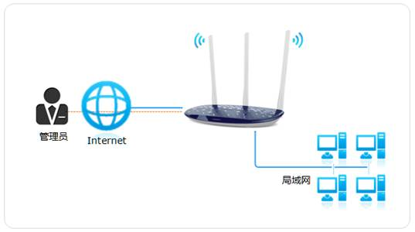
There are many ways to remotely log in to a router, the most common of which is through telnet and SSH modes.
In both modes, you need to set a privileged password on the logged in machine, otherwise you cannot enter the privileged mode.
Introduction to Routers
Remote Access
Working Modes
Commands
Manual Configuration
Experiment

Slide 10
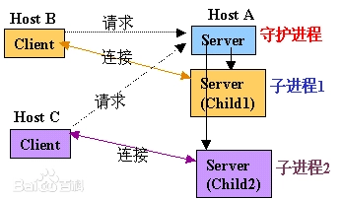
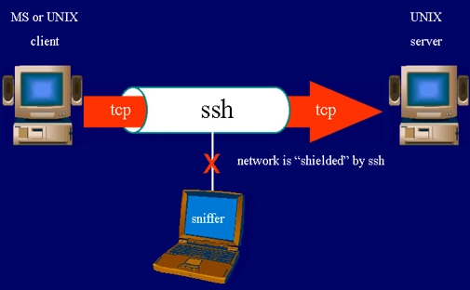
Telnet / SSH
Telnet is a member of the TCP/IP protocol family and is the standard protocol and main mode of remote login service on the Internet. It provides users with the ability to complete remote host work on their local computer. Use the telnet program on the end user's computer and use it to connect to the server. The end user can enter commands in the telnet program, which will run on the server as if they were entered directly on the server's console. You can control the server locally.
SSH is a secure remote login tool based on the TCP protocol, which can encrypt the transmitted data, which is more secure than Telnet. SSH can connect to other computers through the local computer and perform the corresponding operations.
Introduction to Routers
Remote access
Working Modes
Commands
Manual Configuration
Experiment

Slide 11
How to use
When using Telnet/SSH, you need to ensure that the Telnet/SSH service of the logged-in machine is enabled and remote connection is allowed. When configuring Telnet/SSH on a router, it can be done by entering the corresponding command in the command line interface.
Log in to the router using Telnet/SSH:
Enter the telnet router IP address/ssh username@router IP address command on the CLI page of the local computer, for example, telnet 192.168.1.1/ssh admin@192.168.1.1.
Press Enter and try to connect to your router. If the connection is successful, you'll see an output message similar to the following: "Trying 192.168.1.1... Open User Access Verification Password:"/"admin@192.168.1.1's password:".
Enter the privileged password where you entered it. Note that no characters will be displayed when you enter your password, but the password you enter will be processed correctly.
If the password is correct, you will successfully log in to the router's privileged mode and will see an output message similar to the following: "Router#".
Introduction to Routers
Remote Access
Working Modes
Commands
Manual Configuration
Experiment

Slide 12
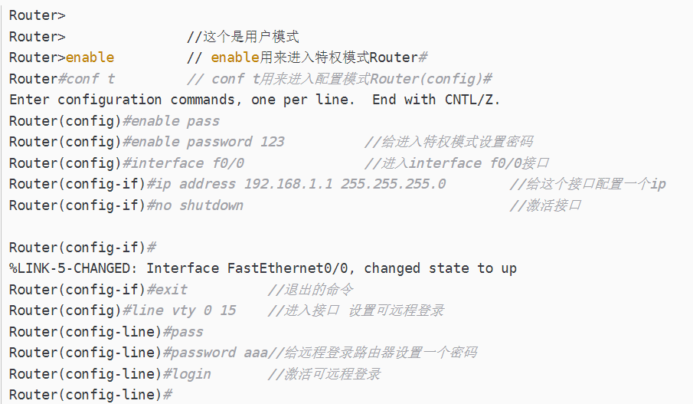
Cisco（Telnet）
1. Configure the router first
Introduction to Routers
Remote Access
Working Modes
Commands
Manual Configuration
Experiment

Slide 13
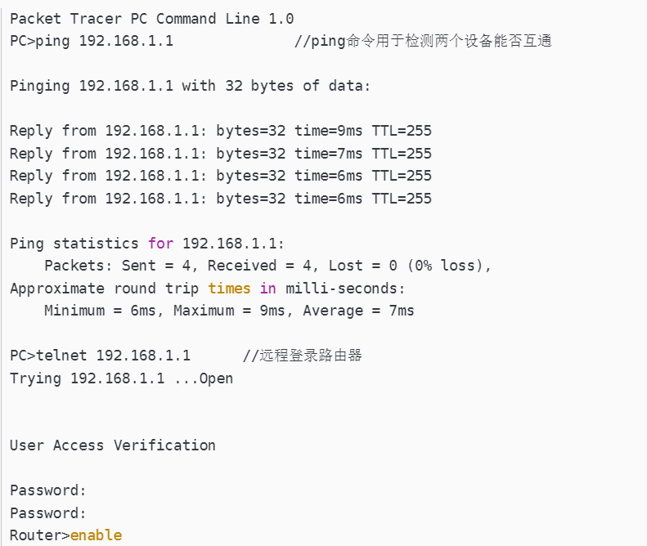
Cisco（Telnet）
2. Use a computer (use the command prompt to log in to the router remotely
Introduction to Routers
Remote Access
Working Modes
Commands
Manual Configuration
Experiment

Slide 14
Other ways
In addition to the above two methods, there are some other ways to remotely log in to the router.
such as: logging in through a traditional public network address; Login through the Nebulas platform, etc
Introduction to Routers
Remote Access
Working Modes
Commands
Manual Configuration
Experiment

Slide 15
PART 03
Five Working Modes
Introduction to Routers
Remote Access
Working Modes
Commands
Manual Configuration
Experiment

Slide 16
User execution mode
As soon as the interface up message appears and press enter, the router> prompt will pop up. This is called user execution mode. This mode is limited to some monitoring commands.
The router is in User EXEC mode, where users can view the router's connectivity status, access other networks and hosts, but cannot view or modify the router's configuration settings.
Introduction to Routers
Remote Access
Working Modes
Commands
Manual Configuration
Experiment

Slide 17
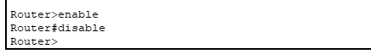
Privilege mode
Privileged mode is the highest level command mode in Cisco routers.
By entering the "enable" command in user EXEC mode, you can access privileged EXEC mode.
In this mode, you can execute privileged operations such as viewing router configurations, running diagnostic commands, modifying system parameters, and more.
Typing ‘disable’ can return to User execution mode
Introduction to Routers
Remote Access
Working Modes
Commands
Manual Configuration
Experiment

Slide 18
Global configuration mode
Global Configuration mode is the primary command mode for configuring the router.
To enter global configuration mode, you use the "configure terminal" command in privileged mode.
In this mode, you can configure various aspects of the router, including network interfaces, routing protocols, access control lists (ACLs), security settings, and more. All configuration changes made in this mode affect the entire router.
Introduction to Routers
Remote Access
Working Modes
Commands
Manual Configuration
Experiment

Slide 19
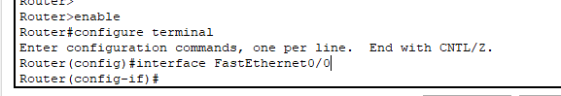
Interface mode
Interface Configuration mode is used to configure specific network interfaces on the router.
To enter interface configuration mode, you use the "interface <interface name>" command (e.g., "interface e0/0") in global configuration mode.
In this mode, you can configure parameters related to the specified interface, such as IP address, subnet mask, maximum transmission unit (MTU), speed, protocols, and more.
Introduction to Routers
Remote Access
Working Modes
Commands
Manual Configuration
Experiment

Slide 20
Line configuration mode
Line Configuration mode is used to configure specific lines (such as console, virtual terminal, auxiliary) on the router.
To enter line configuration mode, you use the "line <line type> <line number>" command (e.g., "line console 0") in global configuration mode.
In this mode, you can configure settings for the specified line, such as setting passwords, controlling access, configuring logging, and more.
Introduction to Routers
Remote Access
Working Modes
Commands
Manual Configuration
Experiment

Slide 21
PART 04
Commands
Introduction to Routers
Remote Access
Working Modes
Commands
Manual Configuration
Experiment

Slide 22
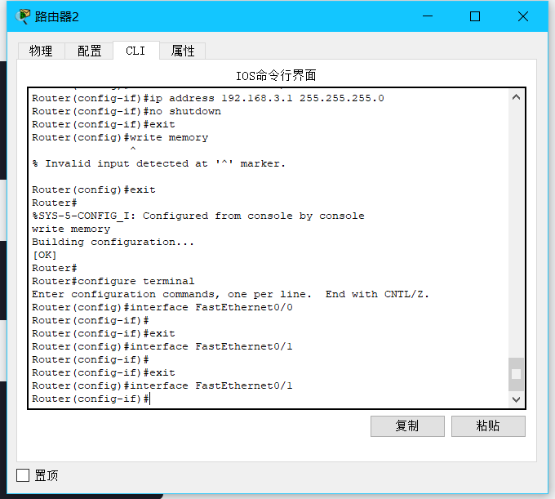
Cisco IOS
Cisco packet tracer is based on IOS（Internetwork Operating System）which can be configurated by entering IOS commands through Command Line Interface， short for CLI
Introduction to Routers
Remote Access
Working Modes
Commands
Manual Configuration
Experiment

Slide 23
Some IOS commands
enable: Enters privileged EXEC mode.
configure terminal: Enters global configuration mode.
interface [interface-name]: Enters interface configuration mode for a specific interface.
ip address [ip-address] [subnet-mask]: Assigns an IP address and subnet mask to an interface.
Introduction to Routers
Remote Access
Working Modes
Commands
Manual Configuration
Experiment

Slide 24
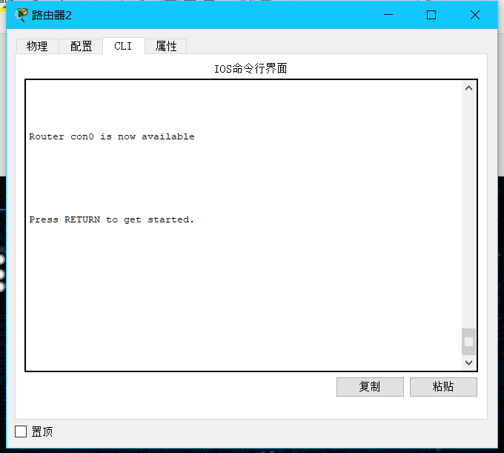
Example for setting IP address on a router interface with IOS commands
open CIL and then press “enter”to start
Introduction to Routers
Remote Access
Working Modes
Commands
Manual Configuration
Experiment

Slide 25
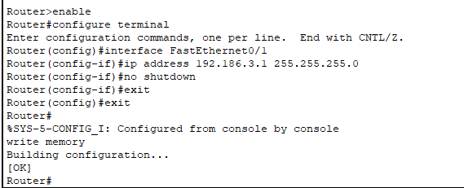
Example for setting IP address on a router interface with IOS commands
Use privileged EXEC mode
Configuration mode
The port to set
setting
Don’t forget to enable the port
Write configuration into router’s memory
Introduction to Routers
Remote Access
Working Modes
Commands
Manual Configuration
Experiment

Slide 26
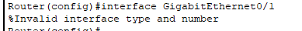
Example for setting IP address on a router interface with IOS commands
Error for wrong input
Introduction to Routers
Remote Access
Working Modes
Commands
Manual Configuration
Experiment

Slide 27
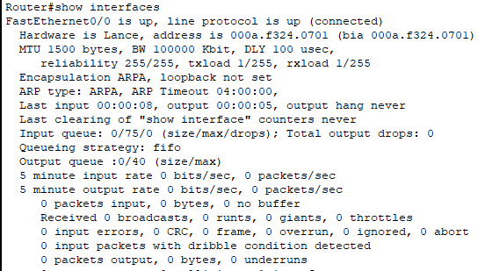
Show router information with show commands
We need to enter privileged mode to use “show” command
Use “show interface” command to show interface information
Introduction to Routers
Remote Access
Working Modes
Commands
Manual Configuration
Experiment

Slide 28
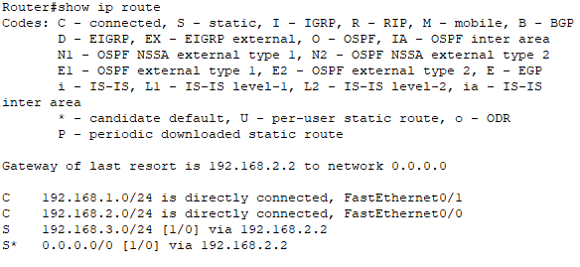
Show router information with show commands
Use “show ip route” command to show ipv4 route information
Introduction to Routers
Remote Access
Working Modes
Commands
Manual Configuration
Experiment

Slide 29
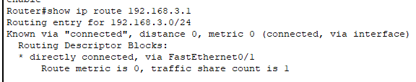
Show router information with show commands
We can also use “show ip route [ip adress]” command to show information for specific ip address
Introduction to Routers
Remote Access
Working Modes
Commands
Manual Configuration
Experiment

Slide 30
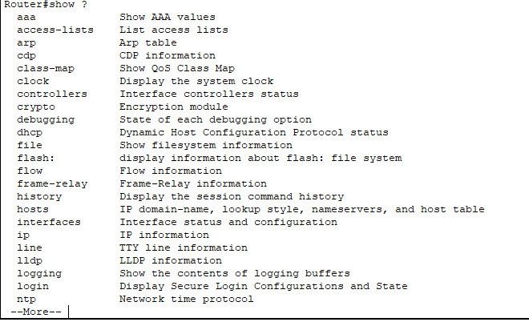
More commands
Append symbol “?” to obtain more commands
Introduction to Routers
Remote Access
Working Modes
Commands
Manual Configuration
Experiment

Slide 31
PART 05
Manual configuration
Introduction to Routers
Remote Access
Working Modes
Commands
Manual Configuration
Experiment

Slide 32
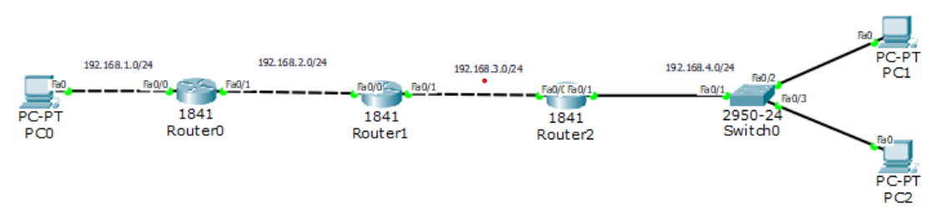
PC0: 192.168.1.1
PC1: 192.168.4.1
PC2: 192.196.4.2
Router0: 192.168.1.254 192.168.2.1
Router1: 192.168.2.2 192.168.3.1
Router2: 192.168.3.2 192.168.4.254
Introduction to Routers
Remote Access
Working Modes
Commands
Manual Configuration
Experiment

Slide 33
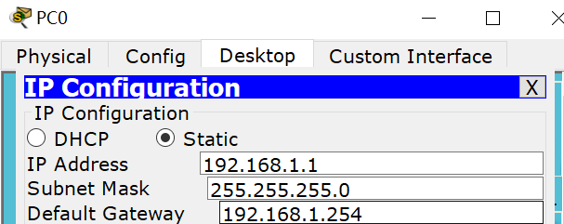
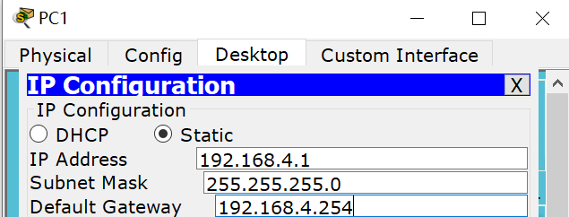
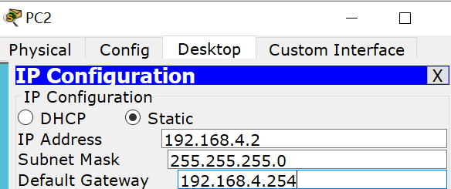
Introduction to Routers
Remote Access
Working Modes
Commands
Manual Configuration
Experiment

Slide 34
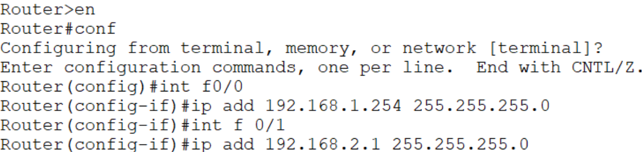
Configure the IP address of routers (take router0 as example).
Introduction to Routers
Remote Access
Working Modes
Commands
Manual Configuration
Experiment

Slide 35
We take the network below as example.
To configure the routers, we need to distinguish between direct and non direct network segments
As the name suggests, the network segment next to the router is a directly connected network segment, not directly adjacent. The network segment with something in between is called a non directly connected network segment
Take Router1 as example：the ip address of the connected network segment are 192.168.2.0 and 192.168.3.0.
Introduction to Routers
Remote Access
Working Modes
Commands
Manual Configuration
Experiment

Slide 36
Static routing configuration
Static routing configuration is quite cumbersome and has a small scope of application
Each router needs to be configured with its non direct network segment
Use this command:
ip route (Non direct network segment) (Non direct network segment Subnet mask) (Next hop address)
Taking router 1 as an example: its non direct network segments are 192.168.1.0/24 and 192.168.4.0/24. The next hop address is the first port that this router passes through when connecting to the non direct network segment we have set up:
Router>en
Router#conf
Router(config)# ip route 192.168.1.0 255.255.255.0 192.168.2.1
Router(config)# ip route 192.168.4.0 255.255.255.0 192.168.3.2
Introduction to Routers
Remote Access
Working Modes
Commands
Manual Configuration
Experiment

Slide 37
Static routing configuration
However, it should be noted that the command below should work on global configuration mode, we only need to add these code before configuring:
Router>en
Router#conf
So for Router0:
Router>en
Router#conf
Router(config)# ip route 192.168.3.0 255.255.255.0 192.168.2.2
Router(config)# ip route 192.168.4.0 255.255.255.0 192.168.2.2 Router2 is similar.
Introduction to Routers
Remote Access
Working Modes
Commands
Manual Configuration
Experiment

Slide 38
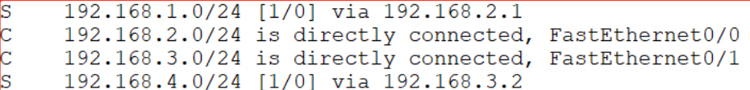
Static routing configuration
After configuring, we can wait a moment and enter show ip route (sh ip ro) in privileged mode to view the routing table.
Just focus on these lines:
C is a direct connected network segment
S is the static route configured for us
Introduction to Routers
Remote Access
Working Modes
Commands
Manual Configuration
Experiment

Slide 39
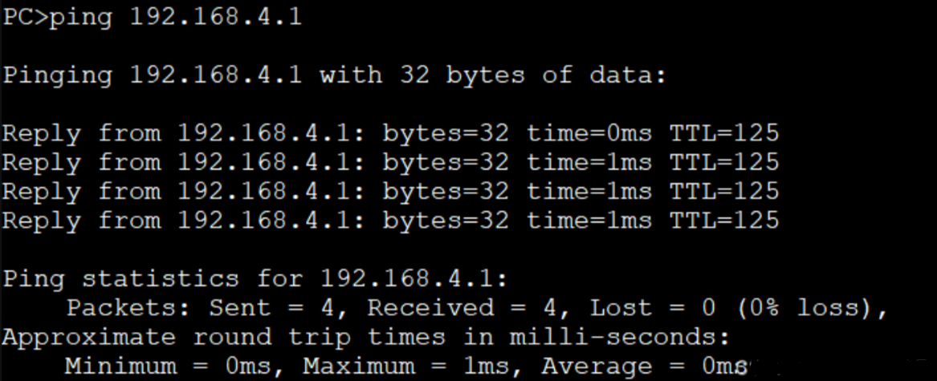
Static routing configuration
Now PCs can communicate with each other:
Introduction to Routers
Remote access
Working Modes
Commands
Manual Configuration
Experiment

Slide 40
PART 06
Experiment on
Cisco Packet Tracer
Introduction to Routers
Remote Access
Working Modes
Commands
Manual Configuration
Experiment

Slide 41

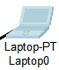
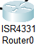
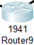
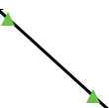

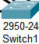
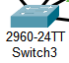


Basic Components
End Devices
Routers
· often leaf nodes of computer
networks
· source / destination of transmitted
data
· used in LAN / WAN to transfer
data in the form of IP packets
· use specific database to decide
the packet’s next path
· often used protocols: static, RIP,
OSPF, BGP etc.
Switches
Cables
· centralize communications on a
computer network
· links adjacent devices
· must adapt to the port of the
linked device
Introduction to Routers
Remote Access
Working Modes
Commands
Manual Configuration
Experiment

Slide 42
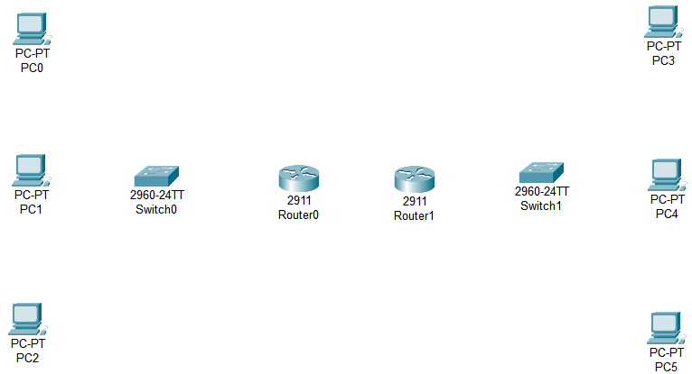
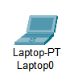
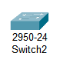
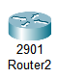
Step 1
Place all the network components on the board.
Models can be replaced with one another as long as there are enough ports.
Introduction to Routers
Remote access
Working Modes
Commands
Manual Configuration
Experiment

Slide 43

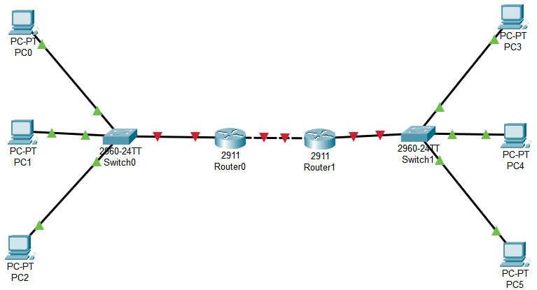
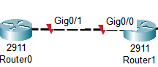
Step 2
Connect the adjacent components.
Use auto choose if you are not sure about which kind of cable to use.
Check the port name by placing the mouse on the cable.
Introduction to Routers
Remote Access
Working Modes
Commands
Manual Configuration
Experiment

Slide 44
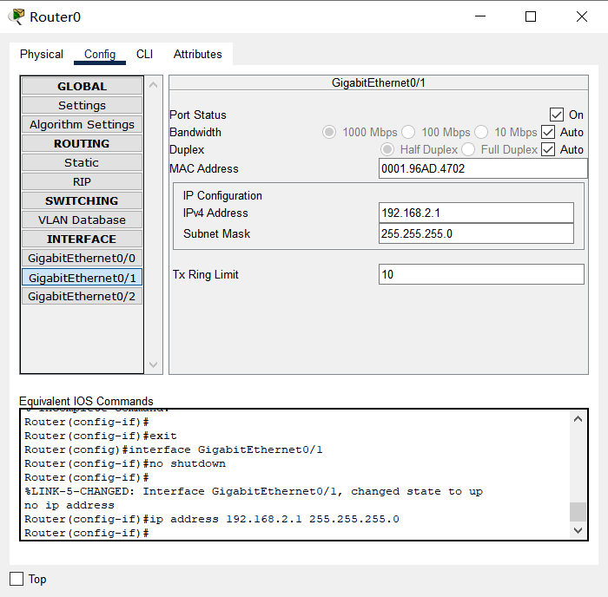
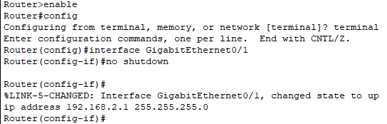
Step 3
Manually configure the IP address of the input and output port of the routers.
Enable the port.
Equivalent to command
#no shutdown
Ensure that you have chosen the right port.
Equivalent to command
#interface <portname>
Give the connection between routers an unused IP address range.
Equivalent to command
#ip address <addr.><mask>
Corresponding setup commands
(preferred to use commands in experiment)
Introduction to Routers
Remote access
Working Modes
Commands
Manual Configuration
Experiment

Slide 45
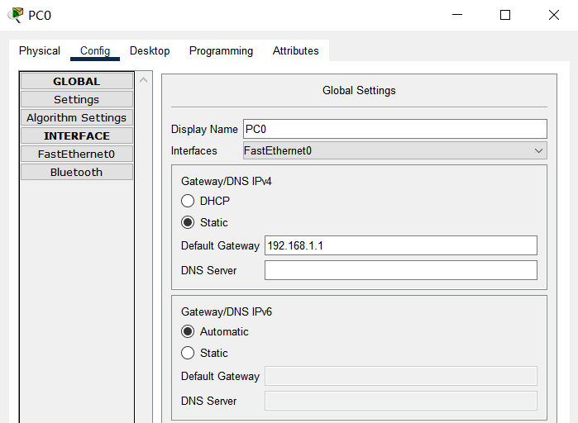
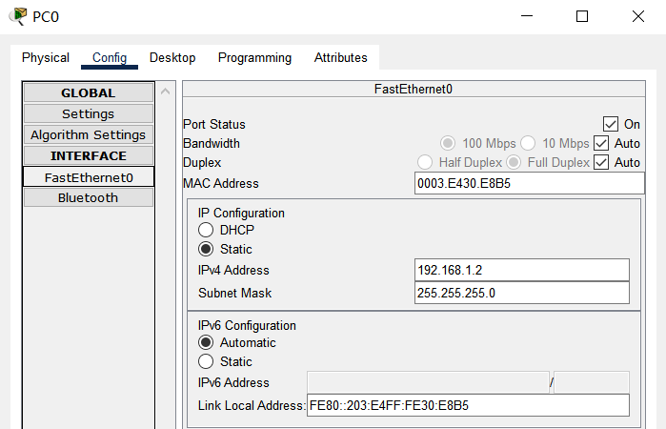
Step 4
Manually configure the IP address and default gateway of the end devices.
The default gateway is set to the IP address of the input port of the corresponding router.
Introduction to Routers
Remote Access
Working Modes
Commands
Manual Configuration
Experiment

Slide 46
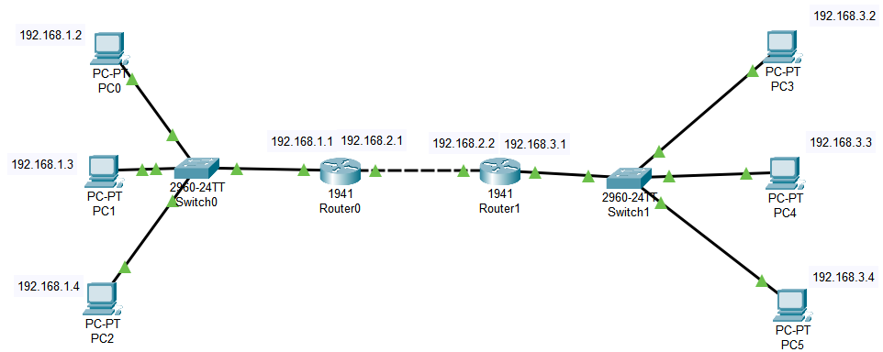
Checkpoint
If everything goes well, the board will be similar as below.
With switches:
Introduction to Routers
Remote Access
Working Modes
Commands
Manual Configuration
Experiment

Slide 47
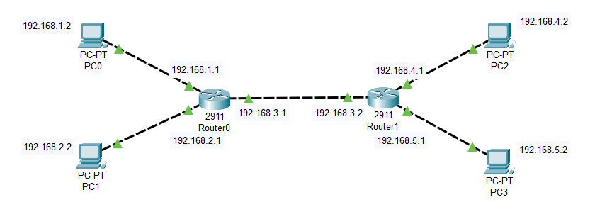
Checkpoint
If everything goes well, the board will be similar as below.
Without switches:
Introduction to Routers
Remote Access
Working Modes
Commands
Manual Configuration
Experiment

Slide 48
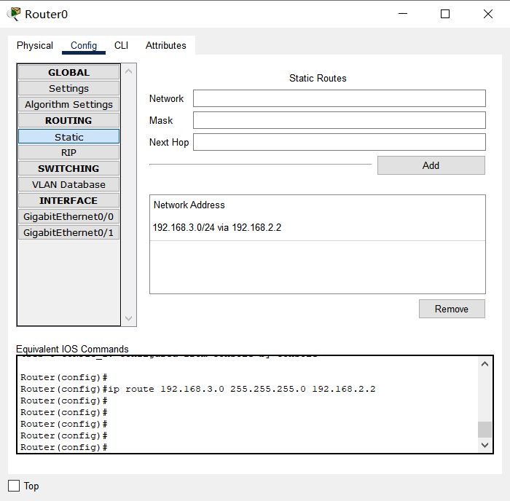
Step 5
Manually configure static routing tables for routers.
The IP address range of the destination device
The IP address of input port of next router
The equivalent command
Introduction to Routers
Remote Access
Working Modes
Commands
Manual Configuration
Experiment

Slide 49
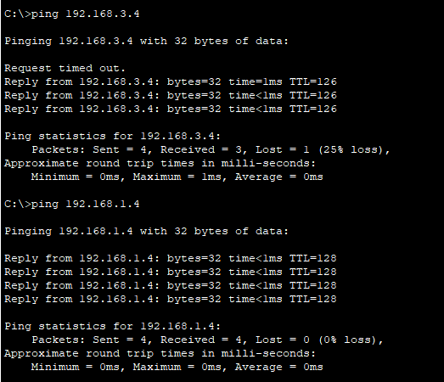
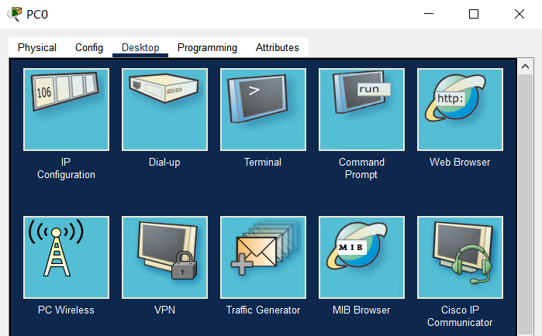
Test
Recommended：
Introduction to Routers
Remote Access
Working Modes
Commands
Manual Configuration
Experiment

Slide 50
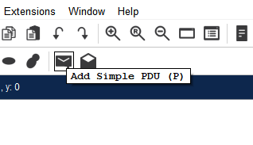
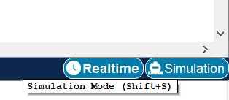
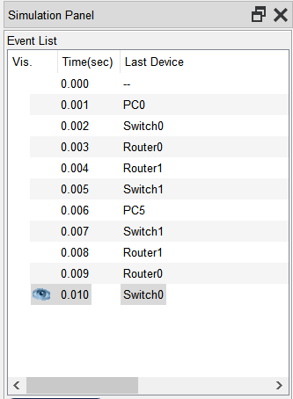
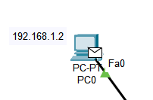

Test
OR:
Introduction to Routers
Remote Access
Working Modes
Commands
Manual Configuration
Experiment

Slide 51
Question
Why the first few packets sent out by the first ping request to another machine are often timed out but the following packets are received successfully?
Introduction to Routers
Remote Access
Working Modes
Commands
Manual Configuration
Experiment

Slide 52
Answer
Because we are doing virtual simulations, we do not consider actual issues such as
· the receiving machine is in initialization process
· network congestion
· quality of service settings
· etc.
ARP (Address Resolution Protocol) Resolution: Before sending Echo Request packets, the sending host needs to determine the MAC address of the destination host. This causes a delay in the transmission of the initial packets, resulting in timeouts. Once the MAC address is resolved, subsequent packets can be sent without delay.
Introduction to Routers
Remote Access
Working Modes
Commands
Manual Configuration
Experiment

Slide 53
Thank You For Listening

